Slide 1
AI-Powered Tools for Literature Reviews
Jason Coleman
Science Librarian
Kansas State University
coleman@k-state.edu
Livia Olsen
Science Librarian
Kansas State University
livia@k-state.edu
Carol Sevin
Science Librarian
Kansas State University
sevin@k-state.edu
Alice Anderson
Instructional Designer
Kansas State University
aliceanderson@k-state.edu

Slide 2
Handout/place for notes/place for questions: https://bit.ly/AI-litrev
Feedback survey: https://bit.ly/AI-litrev-feedback

Slide 3
AI-Powered Tools for Literature Reviews

Slide 4
Varieties of AI-Powered Tools for Literature Reviews
Similarity calculators (aka literature mappers)
User identifies one or more seed papers
Tool analyses networks of citations and/or authorship
Results based on similarity are presented as maps or lists
Notes:
There are scores of tools that use AI to augment the discovery of academic research publications and/or make it easier to learn from the results. After playing with dozens of them, we realized that they fall into three main types. The oldest type are tools that help you find papers that are related to a set you have already found.

Slide 5
Varieties of AI-Powered Tools for Literature Reviews
Semantic Search and Retrieval Augmented Generation
User provides natural language prompt
Tool searches corpus of papers
Results based on semantic relevance are presented as tables and/or answers
Notes:
The second type are tools that use semantic search to enable natural language queries and retrieval augmented generation to provide answers and summaries via a Large-Language model.

Slide 6
Varieties of AI-Powered Tools for Literature Reviews
Document Summarizers and Interrogators
User uploads documents
Tool can answer questions about a specific document or a set of documents
Some tools create reports with analysis and/or summary.
Notes:
The third type are tools that analyze documents you upload. You can chat with your documents. Some provide automatically generated analyses.

Slide 7
Benefits of using semantic search tools with retrieval augmented generation
Reduces need to know search syntax
Reduces need to generate alternate keywords
Enables rapid extraction of answers to specific questions
Expedites screening via customized summaries
Some allow you to query uploaded documents
Facilitate rapid discovery of scholarly vocabulary
Disadvantages of using semantic search tools with retrieval augmented generation
Becomes hard to leverage controlled vocabulary
Corpus is limited - usually to open access journal articles
Generated answers often attribute information to a citing article rather than the cited source
They will confabulate/hallucinate/lie
Can lead to even less close reading of the literature
Notes:
These tools are not far superior to our traditional tools - at least not yet. But they do offer a different experience that can augment that provided by databases like ProQuest Central, JSTOR, and Web of Science.
These tools can help you find papers that are relevant to your research questions. Unfortunately, they can and do make things up - although they are rapidly improving in that regard.

Slide 8
Appropriate vs. inappropriate uses
What do publishers allow you to do with their journal articles and books?
Will journal editors accept a submission that was created with the help of AI?
Are there some uses of these tools that you would not need to acknowledge?
Is it appropriate to upload journal articles to tools like SciSpace or Elicit?
Is it okay to quote the output these tools give you as long as you cite the source?

Slide 9
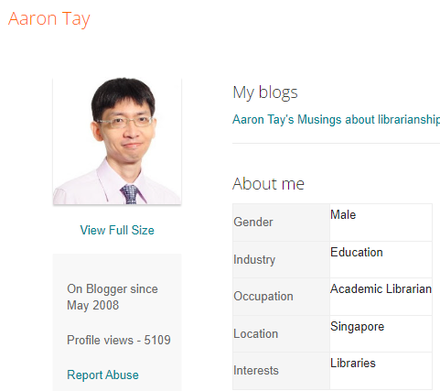
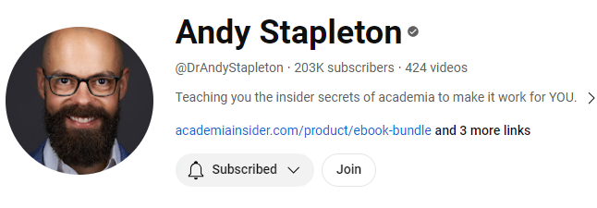
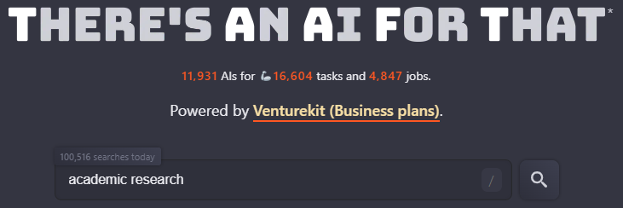
Recommendations for keeping up
2.
3.
https://www.youtube.com/@DrAndyStapleton/playlists
https://www.blogger.com/profile/02750645621492448678
https://theresanaiforthat.com/s/academic+research/
Notes:
We usually end any session about these tools by sharing three of the sources we use for keeping up with this rapidly evolving space. Aaron Tay is a librarian in Singapore who shares in-depth analyses of a wide variety of technologies. Andy Stapleton holds a PhD in Chemistry. He has a wildly successful YouTube channel full of tips about surviving and thriving in graduate school. He can be a bit over the top, but he is entertaining and does a good job of highlighting key features of tools. And There’s an AI for That is a database of information about all sorts of AI tools. We encourage all of you to explore and have fun, but be aware that many of these cost money.

Slide 10
Questions?
Handout/place for notes/place for questions: https://bit.ly/AI-litrev
Feedback survey: https://bit.ly/AI-litrev-feedback
Do you have a question?
你有问题吗？
क्या आपका कोई प्रश्न है?
¿Tienes una pregunta?
Avez-vous une question?
هل لديك سؤال؟
আপনার কি কোনো প্রশ্ন আছে?
У вас есть вопрос?
Você tem uma pergunta?
کیا آپ کے پاس کوئی سوال ہے؟
Apakah Anda memiliki pertanyaan?
Haben Sie eine Frage?
質問はありますか？
Je, una swali?
तुमच्याकडे कोणता प्रश्न आहे का?
మీకు ఏదైనా ప్రశ్న ఉందా?
Bir sorunuz var mı?
질문 있으세요?
Bạn có câu hỏi nào không?
உங்களுக்கு ஏதேனும் கேள்வி உள்ளதா?

